Slide 1
Java, BLAST, SQL, Command Line, and Problems
-Allen Cao

Slide 2
Creating the Fastas to blast
MHC-II, B-Cell, Source Antigen, Proteome
SQL export to csv
Python conversion
Query in Java
acc.next(), acc.getString(k)
Output to txt file

Slide 3
BLASTing Off
cd C:\Users\Allen\My Documents\11th-12th Grade\
makedb -in uniprot.fasta -out uniproteome -dbtype prot
blastp –db uniproteome –query mhcII.fasta –out MHCxUNI.txt -seg no -gapopen 9 -gapextend 1 -word_size 2 -num_alignments 2 -matrix BLOSUM90

Slide 4
Biojava
Built-in parser
Problems with version
Importing certain things won’t work
Benefits of creating own parser:
More work, but more power
Ulysses’ code isn’t simple -> might take same amount of work to understand his code
Easy to edit, simple concept of bufRead.readLine()

Slide 5
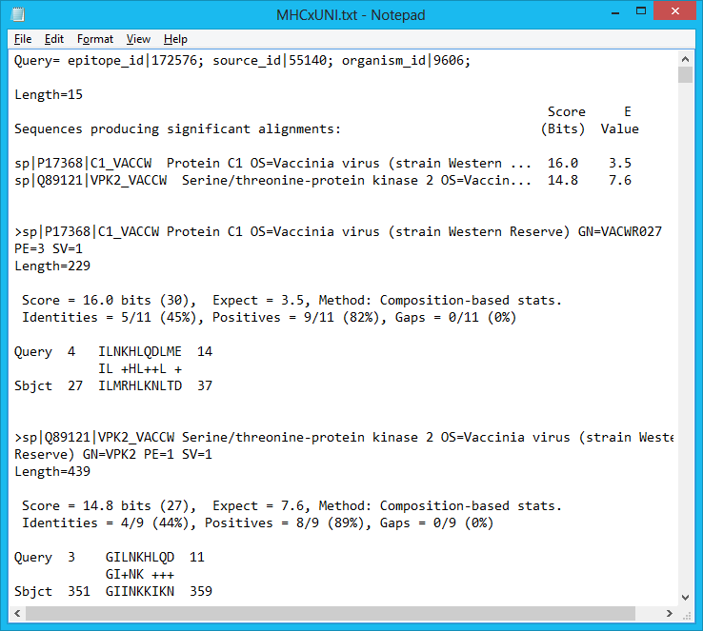
readLine() Situations
readLine() takes in 1 new line
Every new query starts with a line with “Query=“
Sequence similarity is “Identity” followed by a percent
Possible 2 for identity
Peptide positions line starts with “Sbjct”

Slide 6
Convoluted Code: Searches
public static String getNextQuery(BufferedReader br) throws IOException
{
String line,temp="";
do
{
line=br.readLine();
if(line!=null&&line.length()>5)
{
temp=line.substring(0,6);
}
}while (line!=null && !temp.equals("Query="));
return line;
}
public static String getNextIdentity(BufferedReader br) throws IOException
{
String line,temp="";
do
{
line=br.readLine();
if(!line.equals(""))
temp=line.trim().substring(0,2);
}while (line!=null && !temp.equals("Id"));
return line;
}
public static String getNextPositions(BufferedReader br) throws IOException
{
String line,temp="";
do
{
line=br.readLine();
if(!line.equals("") && line.length()>4)
temp=line.substring(0,5);
}while (line!=null && !temp.equals("Sbjct"));
return line;
}

Slide 7
Convoluted Code: Initialization
public static void main(String[] args) throws Exception {
FileReader input = new FileReader("MHCxUNI.txt");
BufferedReader bufRead = new BufferedReader(input);
String myLine = "";
boolean match2=false;
String epitopeInfo="";
int identity1=1;
int identity2=1;
String positions="";
PrintStream out = new PrintStream(new FileOutputStream("MHCxUNIresults.txt"));
System.setOut(out);

Slide 8
Convoluted Code: Main Loop
myLine=getNextQuery(bufRead);
while ( myLine != null){
//myLine=getNextQuery(bufRead);
epitopeInfo=myLine.substring(7);
for(int k =0;k<5;k++)
myLine=bufRead.readLine();
while(!myLine.equals(""))
{
myLine=getNextQuery(bufRead);
epitopeInfo=myLine.substring(7);
for(int k =0;k<5;k++)
myLine=bufRead.readLine();
}
myLine=bufRead.readLine();
myLine=bufRead.readLine();
if(!myLine.equals(""))
match2=true;
myLine=getNextIdentity(bufRead);
identity1=Integer.parseInt(myLine.substring(myLine.indexOf("%")-2, myLine.indexOf("%")));
if(match2)
{
myLine=getNextIdentity(bufRead);
identity2=Integer.parseInt(myLine.substring(myLine.indexOf("%")-2, myLine.indexOf("%")));
}
if(((identity1>=80||identity1==0)&&(identity2<80&&identity2!=0))||((identity1<80&&identity1!=0)&&(identity2>=80||identity2==0)))
{
myLine=getNextPositions(bufRead);
for(int k=0;k<myLine.length();k++)
if(Character.isDigit(myLine.charAt(k)))
positions+=myLine.charAt(k);
out.println(epitopeInfo+"\n "+positions.substring(0,positions.length()/2)+", "+positions.substring(positions.length()/2));
}
myLine=getNextQuery(bufRead);
identity1=1;
identity2=1;
match2=false;
epitopeInfo="";
positions="";
}
out.close();

Slide 9
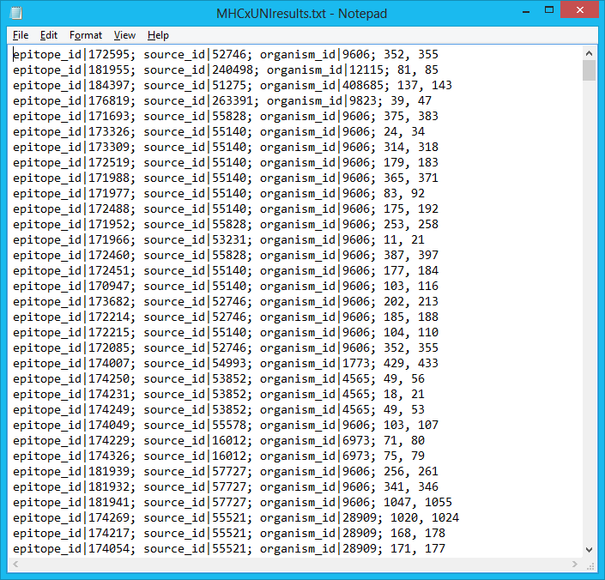

Slide 10
MHCxUNIresults
Epi-id
Src-id
Org-id
pos
SQL
Temp.fasta
>
Epi-id
Src-id
Org-id
Parent-id?
Src Seq
Uniprot
BLAST
Proteome

